Slide 1
BLIP -
A Real-Time Chat And Communication App
A project by
Adarsh Shiv (3B6819A50AC0CC0ACF14332888B744FE)
Prithiv Varma (486B642526DDF91BF494BD8862208A51)
Tharun Nivek (5642C1C6EE5B97480E8432C0FB569615)
Mukhil Adinath (B5E2322414A104098ED483B89EF81E60)

Slide 2
DESCRIPTION
Blip is an interactive communication platform, built using Android's Compose UI toolkit, for seamless messaging. It allows users to connect and communicate easily through real-time text messaging.
Compose UI Integration: Blip showcases the modern declarative approach of Compose UI for UI design. This is how smooth, responsive, and adaptive user interfaces can be created.
Real-Time Messaging: The messages are instantly shown because of efficient state management. So, the flow of the conversation is instant and fluent.
File Sharing: The tool supports various file types such as images, ZIP files, PDFs, etc. Hence, it's an ideal tool for sharing multimedia and documents in the course of chat.
Firebase Integration: Firebase is used by Blip for creating a strong backend to store and retrieve messages, enabling real-time updates in chat windows.
Seamless Navigation: Using composables, the application makes the navigation very smooth, enhancing usability and leading users through the chat threads intuitively.
Blip is an example project for developers that allows them to learn and understand chat capabilities in Android by using Compose and deliver a modern, streamlined user interface.

Slide 3
ChatActivity.kt:
package com.chat.chatapp
import android.content.Intent
import androidx.appcompat.app.AppCompatActivity
import android.os.Bundle
import android.widget.EditText
import android.widget.ImageView
import androidx.recyclerview.widget.LinearLayoutManager
import androidx.recyclerview.widget.RecyclerView
import com.google.firebase.auth.FirebaseAuth
import com.google.firebase.database.*
class ChatActivity : AppCompatActivity() {
private lateinit var chatRecyclerView: RecyclerView
private lateinit var messageBox: EditText
private lateinit var sendButton: ImageView
private lateinit var messageAdapter: MessageAdapter
private lateinit var messageList: ArrayList<Message>
private lateinit var mDbRef: DatabaseReference
var receiverRoom: String? = null
var senderRoom: String? = null

Slide 4
override fun onCreate(savedInstanceState: Bundle?) {
super.onCreate(savedInstanceState)
setContentView(R.layout.activity_chat)
val name = intent.getStringExtra("name")
val receiverUid = intent.getStringExtra("uid")
val senderUid = FirebaseAuth.getInstance().currentUser?.uid
mDbRef = FirebaseDatabase.getInstance().getReference()
senderRoom = receiverUid + senderUid
receiverRoom = senderUid + receiverUid
supportActionBar?.title = name
chatRecyclerView = findViewById(R.id.chatRecyclerView)
messageBox = findViewById(R.id.messageBox)
sendButton = findViewById(R.id.sentButton)
messageList = ArrayList()
messageAdapter = MessageAdapter(this, messageList)
chatRecyclerView.layoutManager = LinearLayoutManager(this)
chatRecyclerView.adapter = messageAdapter

Slide 5
// logic for adding data or chats to recycler view
mDbRef.child("chats").child(senderRoom!!).child("messages")
.addValueEventListener(object : ValueEventListener {
override fun onDataChange(snapshot: DataSnapshot) {
messageList.clear()
for (postSnapshot in snapshot.children) {
val message = postSnapshot.getValue(Message::class.java)
messageList.add(message!!)
}
messageAdapter.notifyDataSetChanged()
}
override fun onCancelled(error: DatabaseError) {
}
})
// adding the message to database
sendButton.setOnClickListener {
val message = messageBox.text.toString()
val messageObject = Message(message, senderUid)
mDbRef.child("chats").child(senderRoom!!).child("messages").push()
.setValue(messageObject).addOnSuccessListener {
mDbRef.child("chats").child(receiverRoom!!).child("messages").push()
.setValue(messageObject) }
messageBox.setText("")
} } }

Slide 6
LoginActivity.kt
package com.chat.chatapp
import android.content.Intent
import androidx.appcompat.app.AppCompatActivity
import android.os.Bundle
import android.widget.Button
import android.widget.EditText
import android.widget.Toast
import com.google.firebase.auth.FirebaseAuth
class LoginActivity : AppCompatActivity() {
private lateinit var edtEmail: EditText
private lateinit var edtPasswoord: EditText
private lateinit var btnLogin: Button
private lateinit var btnSignUp: Button
private lateinit var mAuth : FirebaseAuth
override fun onCreate(savedInstanceState: Bundle?) {
super.onCreate(savedInstanceState)
setContentView(R.layout.activity_login)

Slide 7
mAuth = FirebaseAuth.getInstance()
edtEmail = findViewById(R.id.edt_email)
edtPasswoord = findViewById(R.id.edt_Password)
btnLogin = findViewById(R.id.btn_Login)
btnSignUp = findViewById(R.id.btn_SignUp)
btnSignUp.setOnClickListener {
startActivity(Intent(this, SignupActivity::class.java))
}
btnLogin.setOnClickListener {
val email = edtEmail.text.toString()
val password = edtPasswoord.text.toString()
login(email,password)
}
val user = FirebaseAuth.getInstance().getCurrentUser()
if (user != null)
{
val intent = Intent(this, MainActivity::class.java)
startActivity(intent)
finish()
}
}

Slide 8
private fun login(email: String, password: String) {
mAuth.signInWithEmailAndPassword(email, password)
.addOnCompleteListener(this) { task ->
if (task.isSuccessful) {
// Sign in success, update UI with the signed-in user's information
val intent = Intent(this,MainActivity::class.java)
finish()
startActivity(intent)
} else {
// If sign in fails, display a message to the user.
Toast.makeText(this,"user not exist", Toast.LENGTH_LONG).show()
}
}
}
}
MainActivity.kt
package com.chat.chatapp
import android.content.Intent
import androidx.appcompat.app.AppCompatActivity
import android.os.Bundle

Slide 9
import android.view.Menu
import android.view.MenuItem
import androidx.recyclerview.widget.LinearLayoutManager
import androidx.recyclerview.widget.RecyclerView
import com.google.firebase.auth.FirebaseAuth
import com.google.firebase.database.*
class MainActivity : AppCompatActivity() {
private lateinit var userRecyclerView: RecyclerView
private lateinit var userList: ArrayList<User>
private lateinit var adapter: UserAdapter
private lateinit var mAuth: FirebaseAuth
private lateinit var mDbRef: DatabaseReference
override fun onCreate(savedInstanceState: Bundle?) {
super.onCreate(savedInstanceState)
setContentView(R.layout.activity_main)
mAuth = FirebaseAuth.getInstance()
mDbRef = FirebaseDatabase.getInstance().getReference()
userList = ArrayList()
adapter = UserAdapter(this, userList)

Slide 10
userRecyclerView = findViewById(R.id.userRecyclerView)
userRecyclerView.layoutManager = LinearLayoutManager(this)
userRecyclerView.adapter = adapter
mDbRef.child("user").addValueEventListener(object : ValueEventListener {
override fun onDataChange(snapshot: DataSnapshot) {
userList.clear()
for (postSnapshot in snapshot.children) {
val currentUser = postSnapshot.getValue(User::class.java)
if (mAuth.currentUser?.uid != currentUser?.uid) {
userList.add(currentUser!!)
}
}
adapter.notifyDataSetChanged()
}
override fun onCancelled(error: DatabaseError) {
}
})
}

Slide 11
override fun onCreateOptionsMenu(menu: Menu?): Boolean {
menuInflater.inflate(R.menu.menu, menu)
return super.onCreateOptionsMenu(menu)
}
override fun onOptionsItemSelected(item: MenuItem): Boolean {
if (item.itemId == R.id.logout) {
mAuth.signOut()
val intent = Intent(this, LoginActivity::class.java)
finish()
startActivity(intent)
return true
}
return true
}
}
Message.kt
package com.chat.chatapp
class Message {
var message:String? = null
var senderId: String? = null

Slide 12
constructor(){}
constructor(message:String?,senderId:String?){
this.message = message
this.senderId = senderId
}
}
MessageAdapter.kt
package com.chat.chatapp
import android.content.Context
import android.view.LayoutInflater
import android.view.View
import android.view.ViewGroup
import android.widget.TextView
import androidx.recyclerview.widget.RecyclerView
import com.google.firebase.auth.FirebaseAuth
class MessageAdapter(val context: Context, val messageList: ArrayList<Message>) :
RecyclerView.Adapter<RecyclerView.ViewHolder>() {
val ITEM_RECEIVE = 1
val ITEM_SENT = 2

Slide 13
override fun onCreateViewHolder(parent: ViewGroup, viewType: Int): RecyclerView.ViewHolder {
if (viewType == 1) {
// inflate receive
val view: View = LayoutInflater.from(context).inflate(R.layout.receive, parent, false)
return ReceiveViewHolder(view)
} else {
// inflate sent
val view: View = LayoutInflater.from(context).inflate(R.layout.sent, parent, false)
return SentViewHolder(view)
}
}
override fun onBindViewHolder(holder: RecyclerView.ViewHolder, position: Int) {
val currentMessage = messageList[position]
if (holder.javaClass == SentViewHolder::class.java) {
//stuff for sent view holder
val viewHolder = holder as SentViewHolder
holder.sentMessage.text = currentMessage.message
} else {
//stuff for receive view holder
val viewHolder = holder as ReceiveViewHolder
holder.receiveMessage.text = currentMessage.message
}
}

Slide 14
override fun getItemViewType(position: Int): Int {
val currentMessage = messageList[position]
if (FirebaseAuth.getInstance().currentUser?.uid.equals(currentMessage.senderId)) {
return ITEM_SENT
} else {
return ITEM_RECEIVE
}
}
override fun getItemCount(): Int {
return messageList.size
}
class SentViewHolder(itemView: View) : RecyclerView.ViewHolder(itemView) {
val sentMessage = itemView.findViewById<TextView>(R.id.txt_sent_message)
}
class ReceiveViewHolder(itemView: View) : RecyclerView.ViewHolder(itemView) {
val receiveMessage = itemView.findViewById<TextView>(R.id.txt_receive_message)
}
}

Slide 15
SignupActivity.kt
package com.chat.chatapp
import android.content.Intent
import androidx.appcompat.app.AppCompatActivity
import android.os.Bundle
import android.widget.Button
import android.widget.EditText
import android.widget.Toast
import com.google.firebase.auth.FirebaseAuth
import com.google.firebase.database.DatabaseReference
import com.google.firebase.database.FirebaseDatabase
class SignupActivity : AppCompatActivity() {
private lateinit var edtEmail: EditText
private lateinit var edtPasswoord: EditText
private lateinit var edtName: EditText
private lateinit var btnSignUp: Button
private lateinit var mAuth: FirebaseAuth
private lateinit var mDbRef: DatabaseReference
override fun onCreate(savedInstanceState: Bundle?) {
super.onCreate(savedInstanceState)
setContentView(R.layout.activity_signup)

Slide 16
mAuth = FirebaseAuth.getInstance()
edtName = findViewById(R.id.edt_Name)
edtEmail = findViewById(R.id.edt_email)
edtPasswoord = findViewById(R.id.edt_Password)
btnSignUp = findViewById(R.id.btn_SignUp)
btnSignUp.setOnClickListener {
val name = edtName.text.toString()
val email = edtEmail.text.toString()
val password = edtPasswoord.text.toString()
signUp(name,email,password)
}
}
private fun signUp(name: String, email: String, password: String) {
mAuth.createUserWithEmailAndPassword(email, password)
.addOnCompleteListener(this) { task ->
if (task.isSuccessful) {
addUserToDatabase(name, email, mAuth.currentUser?.uid!!)
// Sign in success, update UI with the signed-in user's information
val intent = Intent(this,MainActivity::class.java)
finish()
startActivity(intent)

Slide 17
} else {
// If sign in fails, display a message to the user.
Toast.makeText(this, "error", Toast.LENGTH_LONG).show()
}
}
}
private fun addUserToDatabase(name: String, email: String, uid: String?) {
mDbRef = FirebaseDatabase.getInstance().getReference()
mDbRef.child("user").child(uid!!).setValue(User(name,email,uid))
}
}
SplashActivity.kt
package com.chat.chatapp
import android.content.Intent
import androidx.appcompat.app.AppCompatActivity
import android.os.Bundle
import android.os.Handler
import androidx.appcompat.app.AppCompatDelegate

Slide 18
class SplashActivity : AppCompatActivity() {
override fun onCreate(savedInstanceState: Bundle?) {
super.onCreate(savedInstanceState)
setContentView(R.layout.activity_splash)
AppCompatDelegate.setDefaultNightMode(AppCompatDelegate.MODE_NIGHT_NO)
Handler().postDelayed({
startActivity(Intent(this, LoginActivity::class.java))
finish()
}, 2000)
}
}
User.kt
package com.chat.chatapp
class User {
var name:String?=null
var email:String?=null
var uid:String?=null
constructor(){}

Slide 19
constructor(name:String?,email:String?,uid:String?){
this.name = name
this.email = email
this.uid = uid
}
}
UserAdapter.kt
package com.chat.chatapp
import android.content.Context
import android.content.Intent
import android.view.LayoutInflater
import android.view.View
import android.view.ViewGroup
import android.widget.TextView
import androidx.recyclerview.widget.RecyclerView
import com.google.firebase.auth.FirebaseAuth
class UserAdapter(val context: Context, val userList: ArrayList<User>) :
RecyclerView.Adapter<UserAdapter.UserViewHolder>() {

Slide 20
val view: View = LayoutInflater.from(context).inflate(R.layout.user_layout, parent, false)
return UserViewHolder(view)
}
override fun onBindViewHolder(holder: UserViewHolder, position: Int) {
val currentUser = userList[position]
holder.textName.text = currentUser.name
holder.itemView.setOnClickListener {
val intent = Intent(context, ChatActivity::class.java)
intent.putExtra("name",currentUser.name)
intent.putExtra("uid",currentUser.uid)
context.startActivity(intent)
}
}
override fun getItemCount(): Int {
return userList.size
}
class UserViewHolder(itemView: View) : RecyclerView.ViewHolder(itemView) {
val textName = itemView.findViewById<TextView>(R.id.txtName)
}
}

Slide 21
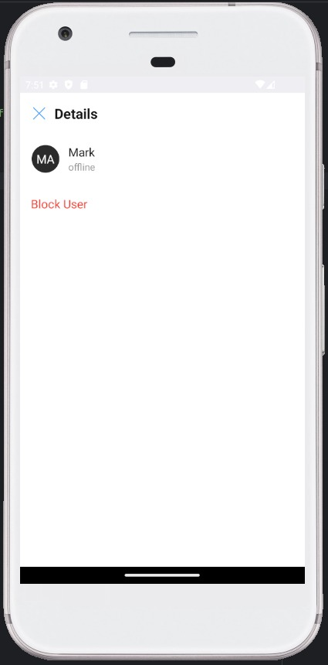
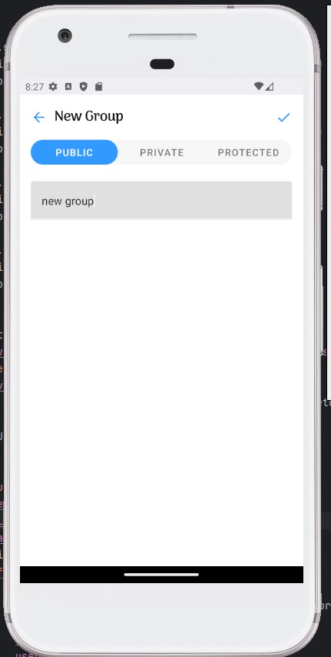
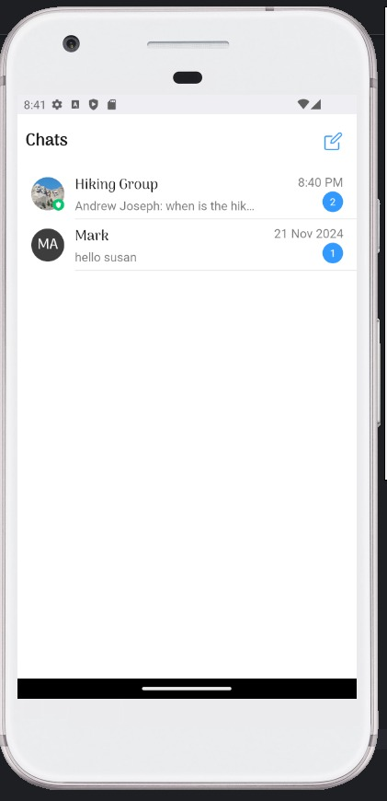
Output:

Slide 22
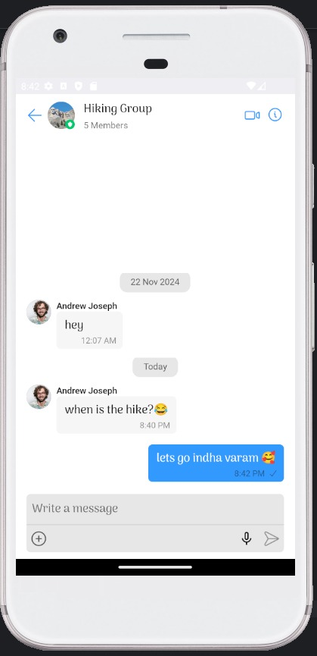
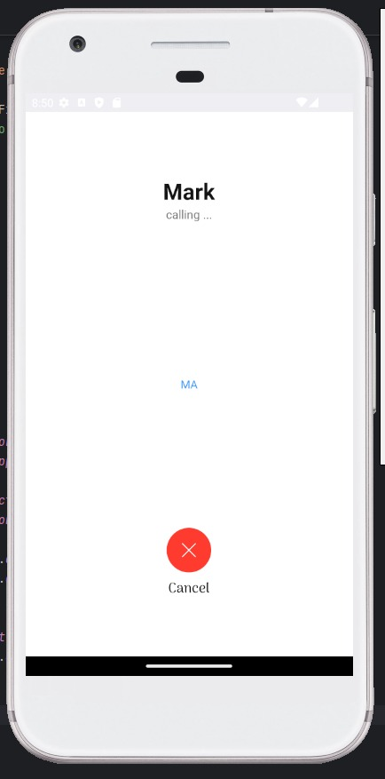
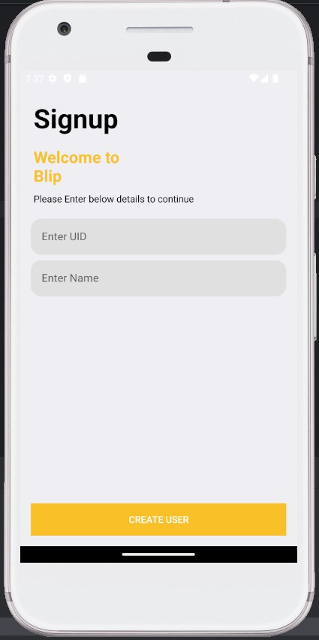

Slide 23
